Slide 1

MAUD School
Structural Analysis of Nanomaterials
using Electron Diffraction
Philippe BOULLAY
Cristallographie et Sciences des Matériaux – CRISMAT UMR 6508 CNRS – Caen, France
Electron Powder Diffraction : Rietveld analyses using MAUD
Intensity extraction from images pp. 02-08
Sizes, shapes and textures pp. 09-15
Structure refinements pp. 16-19
P. Boullay, L. Lutterotti, D. chateigner and L. Sicard, Acta Cryst. A 70 (2014) 448-456
Fast Microstructure and Phase Analyses of Nanopowders using Combined Analysis of TEM scattering patterns

Slide 2
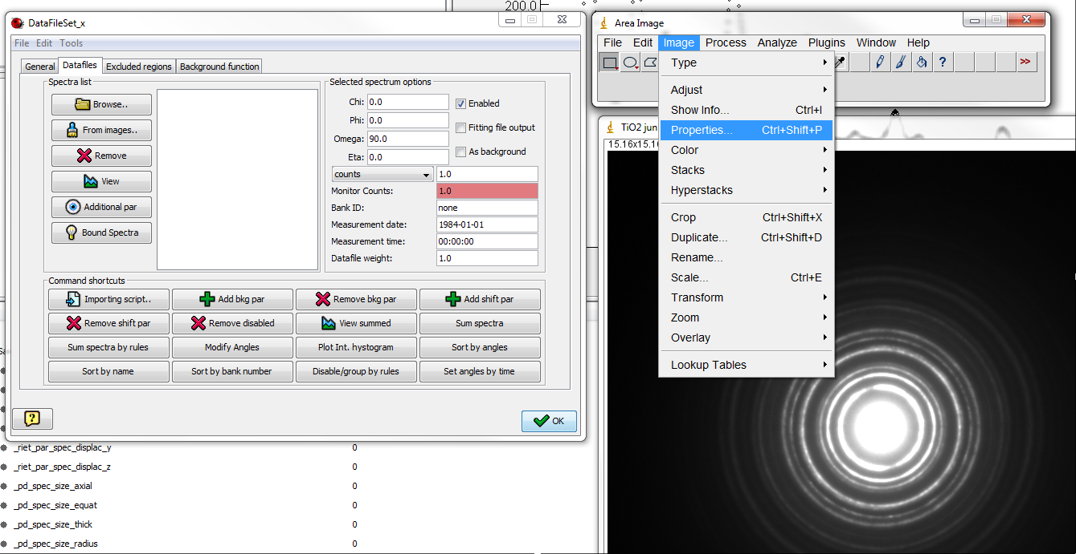
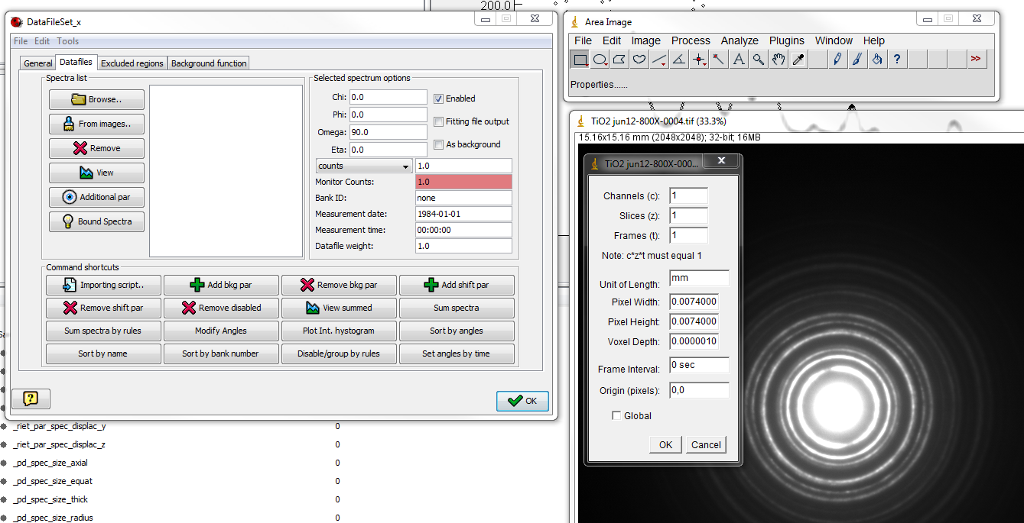
Structural Analysis of Nanomaterials
using Electron Diffraction
Intensity extraction along the rings by segments using an ImageJ plugin
❷
❶
pixel size
only dependent of the specification of your CCD camera► pixel to mm

Slide 3
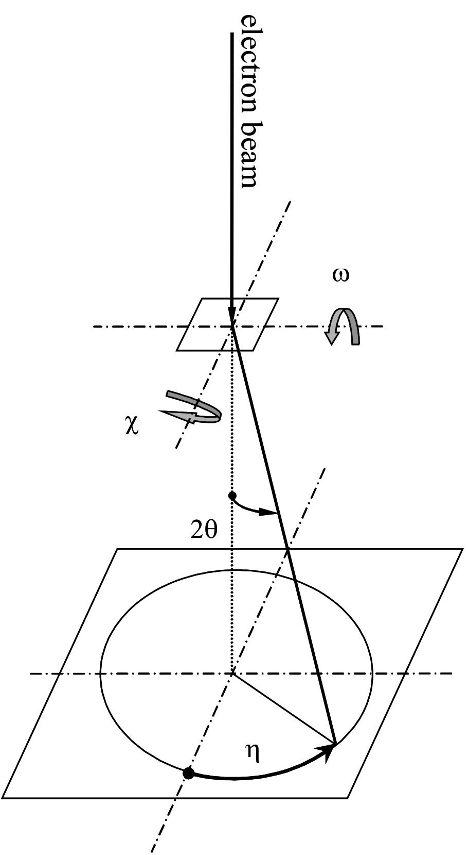
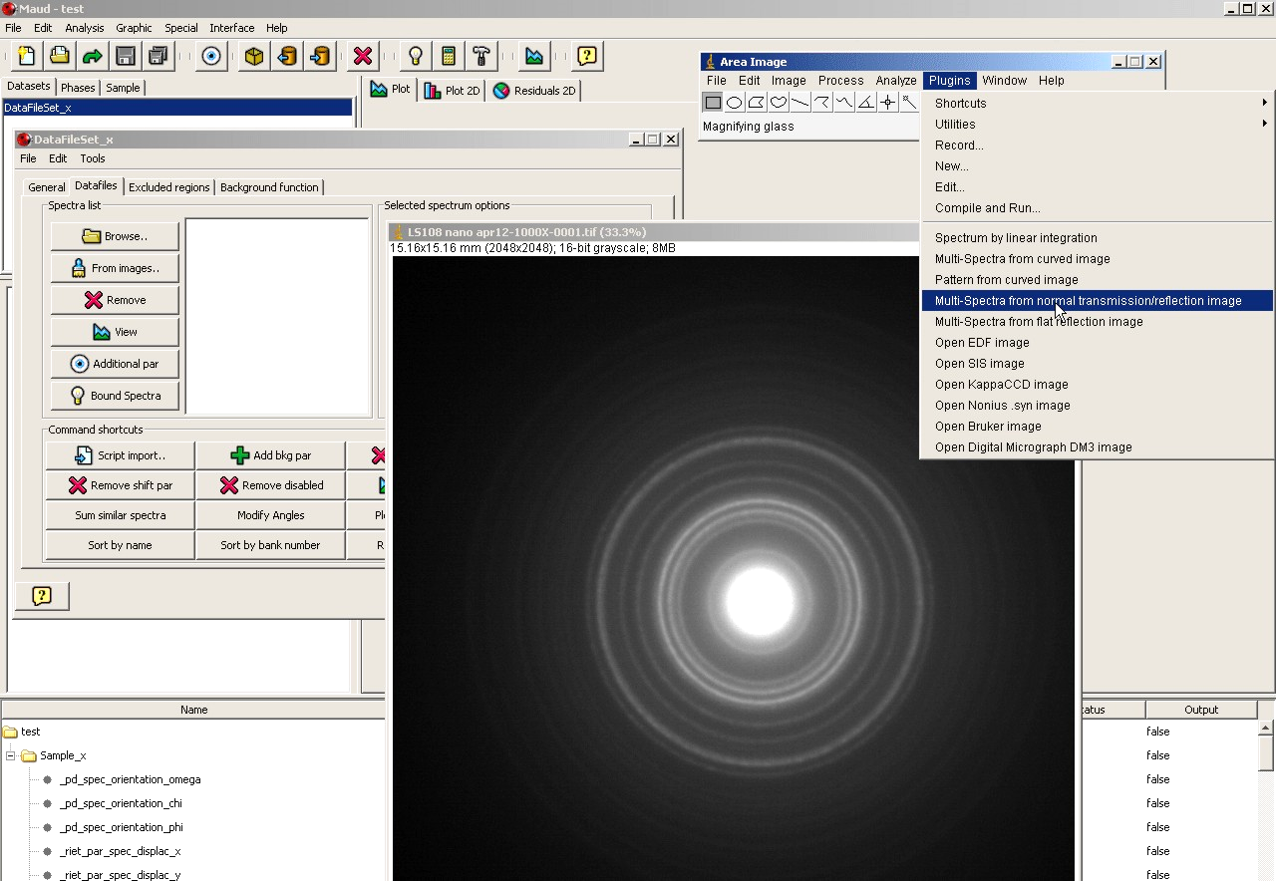
Structural Analysis of Nanomaterials
using Electron Diffraction
Intensity extraction along the rings by segments using an ImageJ plugin
❸
120 patterns
3°
CAKING
chi=phi=0° / omega=90° / eta: 0° to 360°
Transmission geometry for TEM scattering experiments with the nomenclature used in MAUD

Slide 4
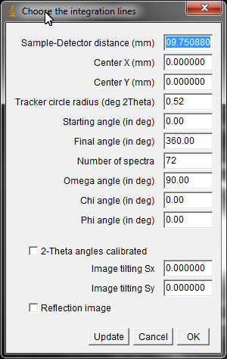
Structural Analysis of Nanomaterials
using Electron Diffraction
Intensity extraction along the rings by segments using an ImageJ plugin
❸
72 patterns
estimation of the center position using a reference circle on the screen
5°
CAKING
chi=phi=0° / omega=90° / eta: 0° to 360°

Slide 5
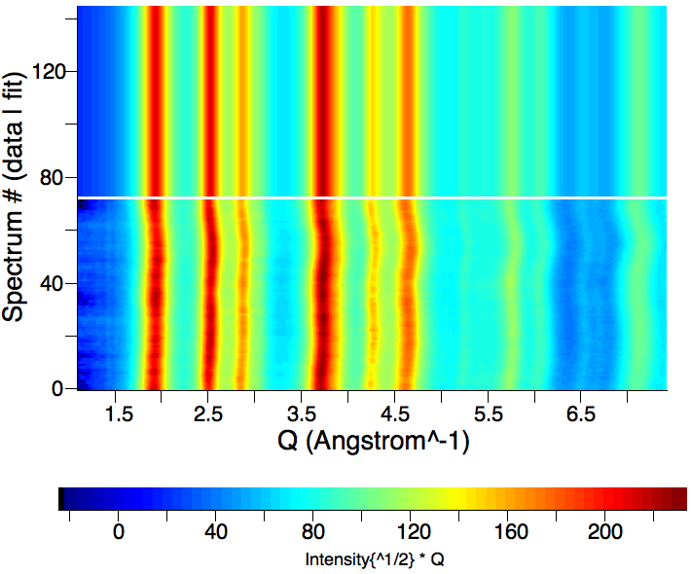
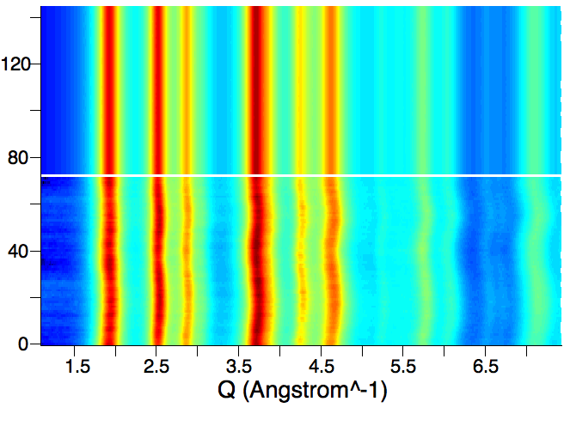
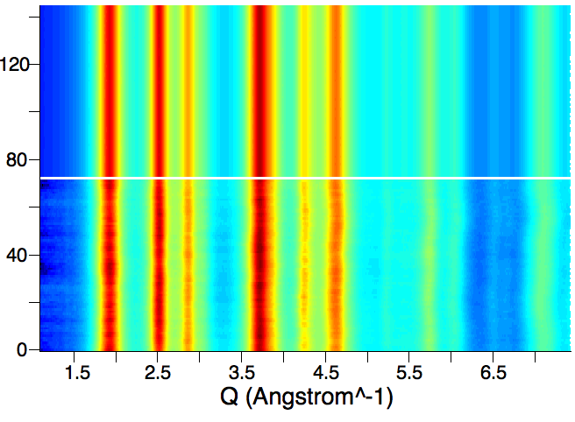
Structural Analysis of Nanomaterials
using Electron Diffraction
Corrections for center position and elliptical distortion ?
Pawley fitting refining centre and tilting
x-center error = -0.00755(4) mm
y-center error = -0.01093(4) mm
tilting error x (sin(error)) = -0.0048(3)
tilting error y (sin(error)) = 0.1211(3)
Rwp = 1.56 %
Pawley fitting refining center but not tilting
x-center error = -0.00717(5) mm
y-center error = -0.01278(5) mm
Rwp = 2.32 %
Pawley fitting without refining center or tilting
Centre defined graphically on the image
Rwp = 2.83 %

Slide 6
Structural Analysis of Nanomaterials
using Electron Diffraction
Intensity extraction along the rings by segments using an ImageJ plugin
?
not important here BUT
❸
72 patterns
estimation of the center position using a reference circle on the screen
5°
CAKING
chi=phi=0° / omega=90° / eta: 0° to 360°
we have to calibrate the distance specimen/detector ► mm to 2θ

Slide 7
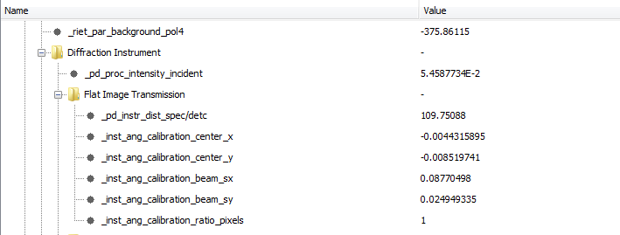
Structural Analysis of Nanomaterials
using Electron Diffraction
Intensity extraction along the rings by segments using an ImageJ plugin
calibrate the distance specimen/detector using a « reference material »
► an assembly of nanoparticles with known SG and lattice parameters
► best if microstructural features (size, shape, ….) are known (from XRPD)
Camera length read on the TEM (mm) | Apparent spec/detc distance (mm)
600 | 109.9
800 | 145.3
1000 | 180.6
1200 | 229.4
1500 | 271.2
2000 | 375.1
▼
▼
▼
▼

Slide 8
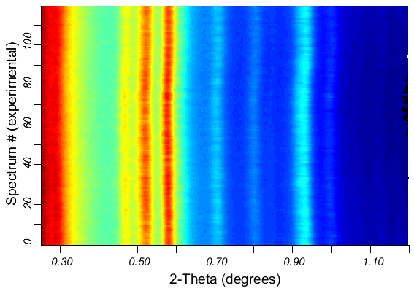
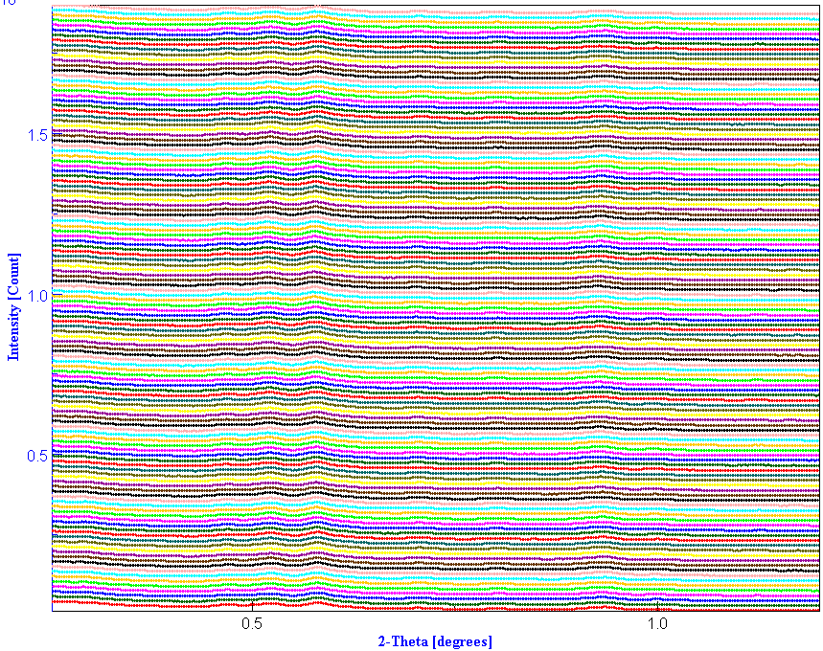
Structural Analysis of Nanomaterials
using Electron Diffraction
Intensity extraction along the rings by segments using an ImageJ plugin
120 patterns
2D plot
estimation of the center position using a reference circle on the screen
3°
CAKING
chi=phi=0° / omega=90° / eta: 0° to 360°

Slide 9
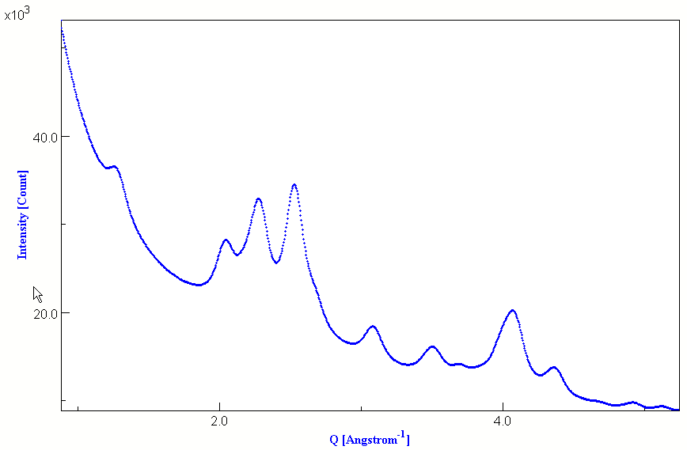
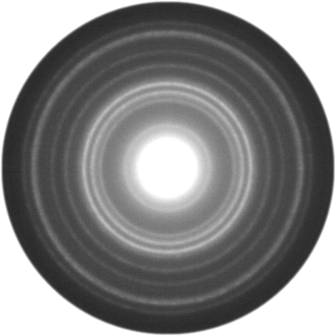
Structural Analysis of Nanomaterials
using Electron Diffraction
1D XRPD-like pattern (360° summed intensity)
peak location and intensities
peak broadening vs. d_{hkl}
b(x): background => pic at 0° + polynomial function
2θ (°) => Q (Å⁻¹)
measured profile h(x) = f(x) ⊗ g(x) + b(x)

Slide 10
Structural Analysis of Nanomaterials
using Electron Diffraction
Line broadening causes
instrumental broadening
finite size of the crystals (acts like a Fourier truncation: size broadening)
imperfection of the periodicity (due to d_{h} variations inside crystals: microstrain effect)
generally: 0D, 1D, 2D, 3D defects
All quantities are average values over the probed volume
► electrons, x-rays, neutrons: complementary
► distributions: mean values depend on distributions’ shapes
h(x) = f(x) ⊗ g(x) + b(x)
sample contribution
instrumental broadening
Extraction of f(x) can be obtained by a whole-pattern (Rietveld) analysis
Need to know g(x) the instrumental broadening !
The instrumental Peak Shape Function is obtained by analysing nanoparticules of known sizes and shapes as obtained from X-ray analyses
L. Lutterotti and P. Scardi, J. of Appl. Crystallogr. 23, 246-252 (1990)

Slide 11
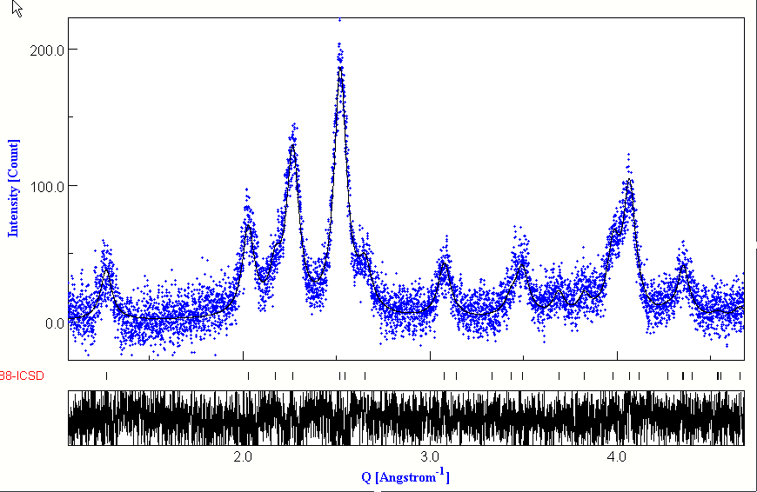
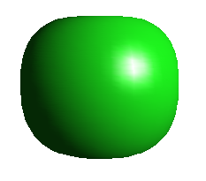
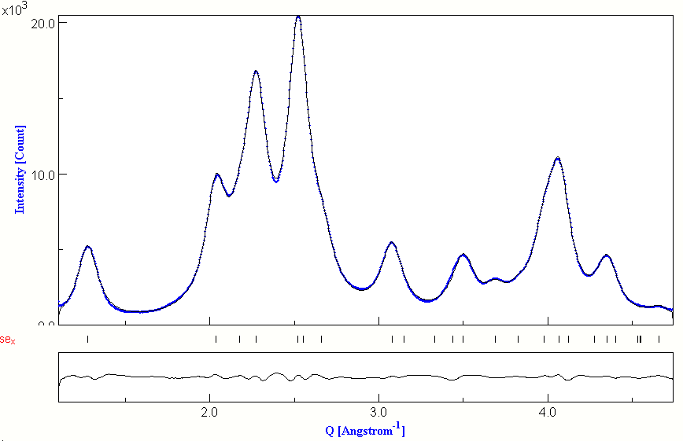
Structural Analysis of Nanomaterials
using Electron Diffraction
Mn₃O₄ hausmannite
g(x) ► f(x)
structure
Bruker D8 / Lynx Eye 1D
λ=1.54056 Å (Cu Kα₁)
SG: I 4₁/a m d
a=5.764(2)Å and c=9.448(4)Å
64 Å
POPA
anisotropic
shape
53 Å
f(x) ► g(x)
pattern matching
background substracted
TOPCON 2B / CCD ORIUS
λ=0.0251Å
a=5.7757(2)Å and c=9.4425(4)Å
Cagliotti function
U=3.32 10⁻⁴
V=-2.5 10⁻²
W=3.2
TEM : poor resolution ! ►not for particles larger than 20 nm

Slide 12
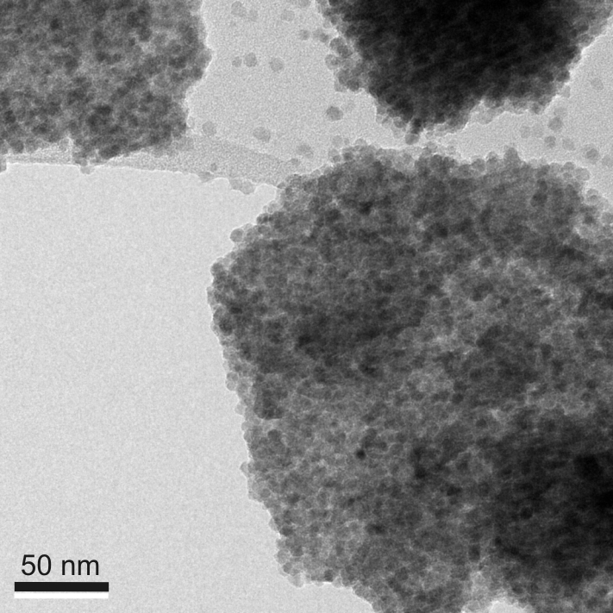
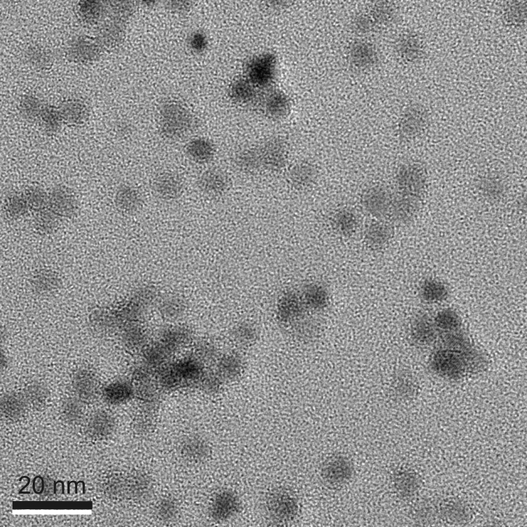
Structural Analysis of Nanomaterials
using Electron Diffraction
Mn₃O₄ hausmannite
64 Å
POPA
anisotropic
shape
53 Å
TOPCON 2B / CCD ORIUS
λ=0.0251Å
a=5.7757(2)Å and c=9.4425(4)Å
f(x) ► g(x)

Slide 13
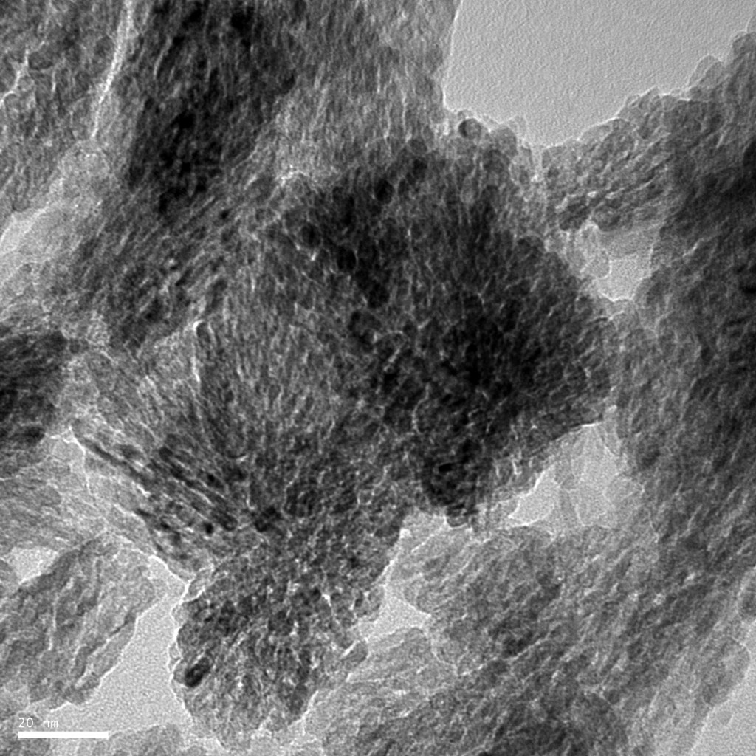

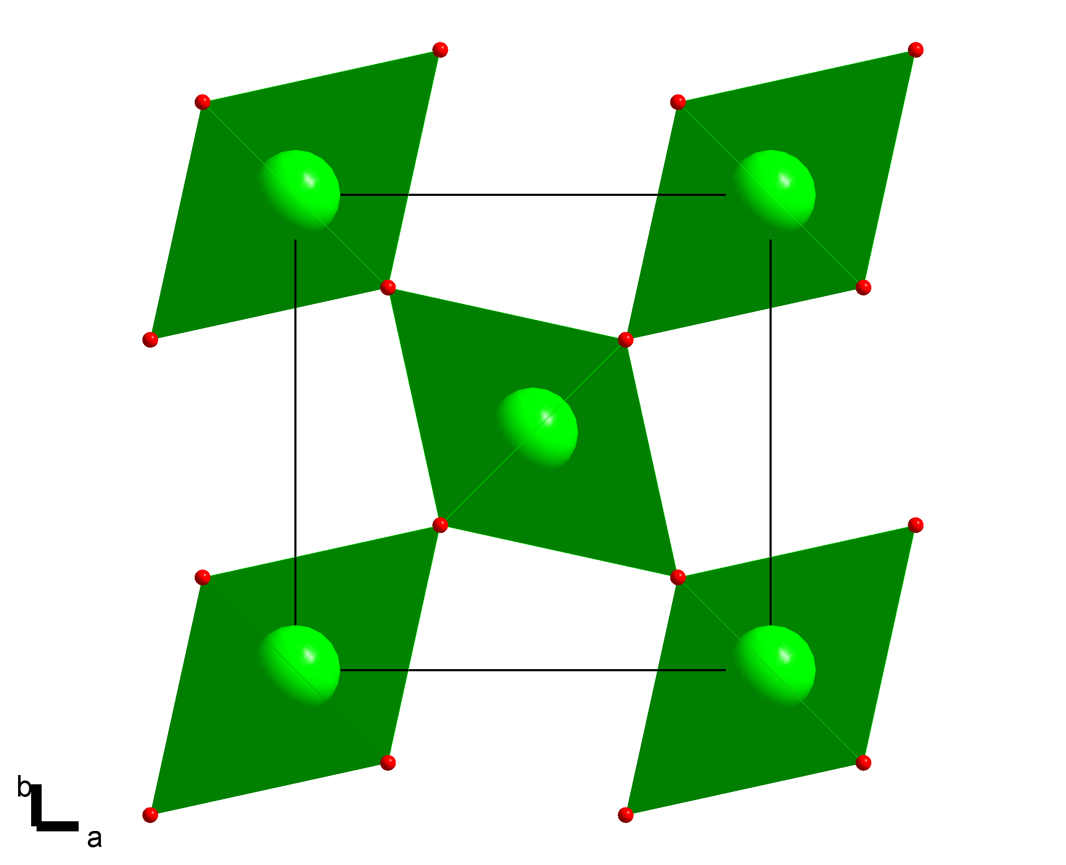
Structural Analysis of Nanomaterials
using Electron Diffraction
Microstructure of nanocrystalline materials: TiO₂ rutile ⁽¹⁾
from phase search: TiO₂ rutile P4₂/mnm a= 4.592Å a=2.957Å (COD database ID n°9001681)
72 patterns
5°
20nm
FEI Tecnai / CCD USC1000 / λ=0.0197Å
M. Reddy et al., ElectroChem. Com. 8 (2006) 1299-1303

Slide 14
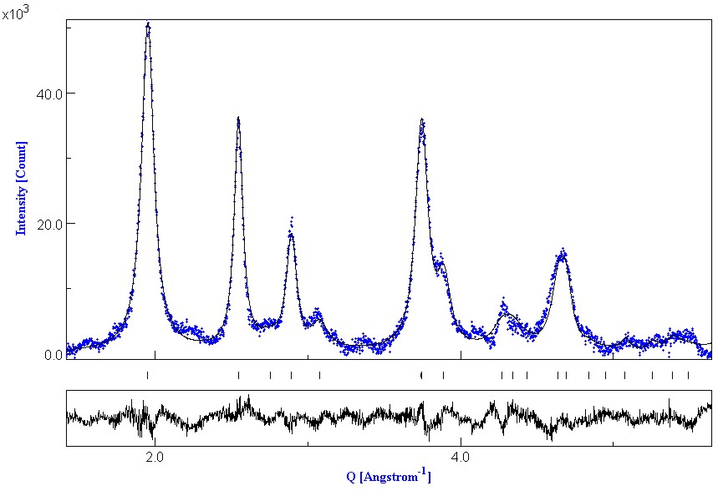
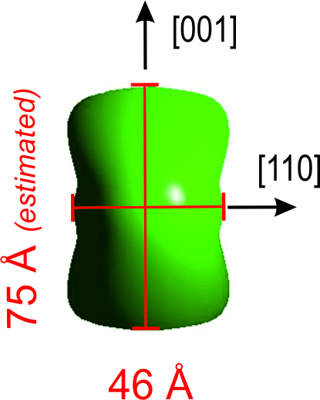
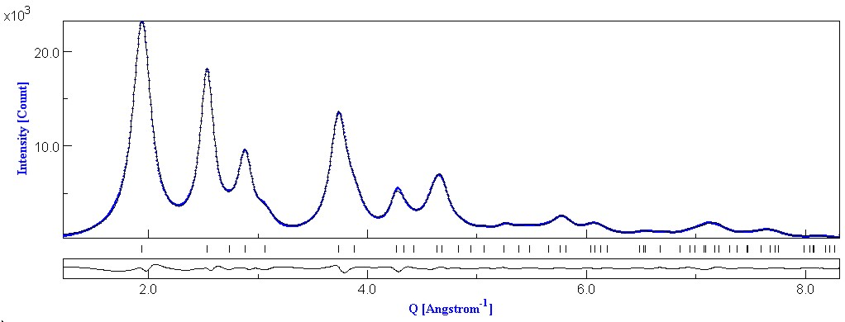
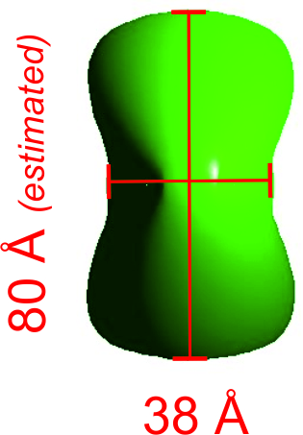
Structural Analysis of Nanomaterials
using Electron Diffraction
4-circles diffract. / INEL CPS
λ= CuKα
structure
XRPD
average anisotropic crystallite size
POPA (up to R4)
pattern matching
EPD

Slide 15
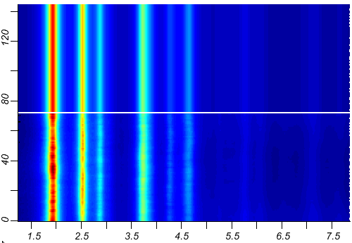
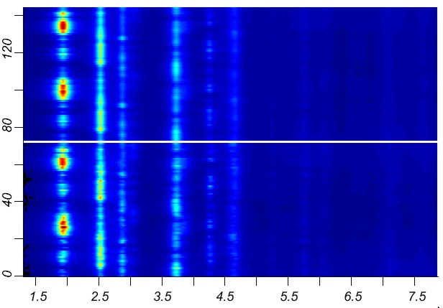
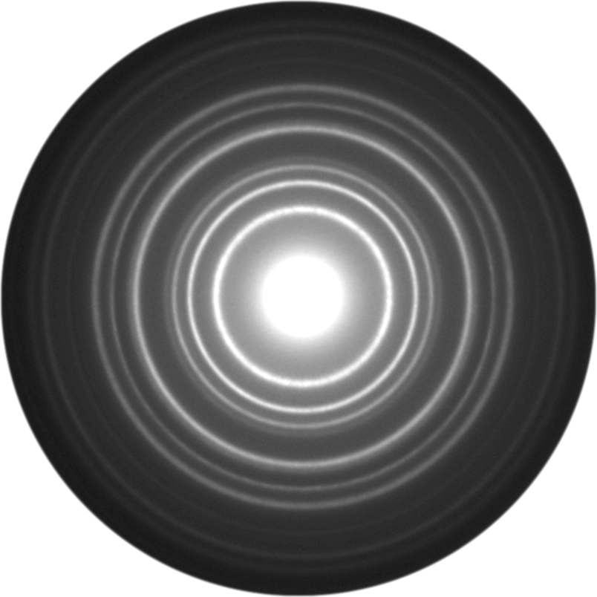
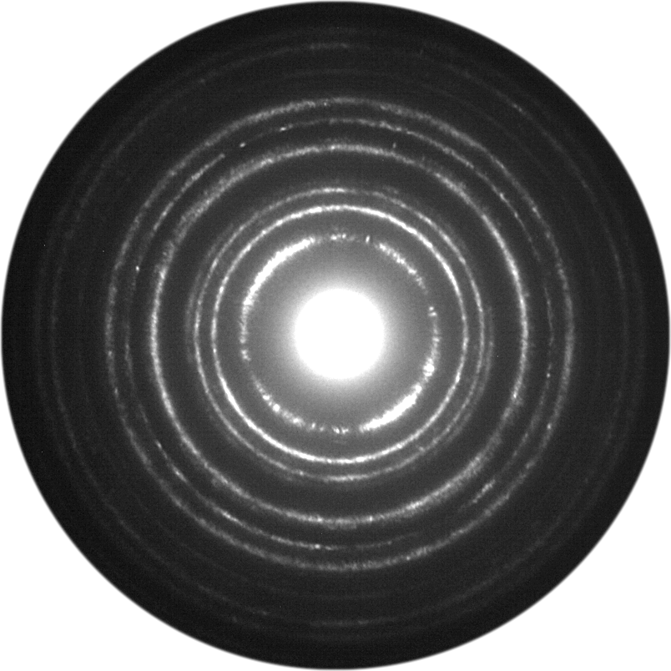
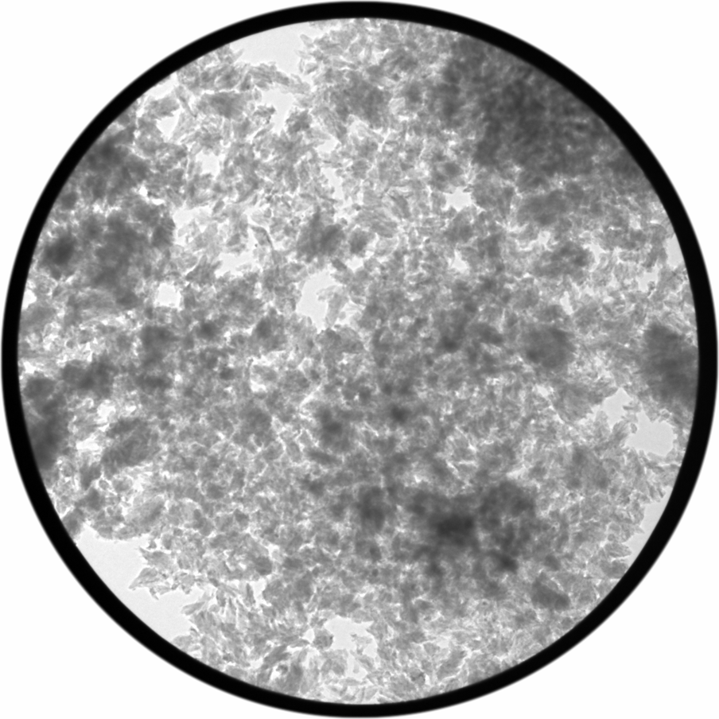
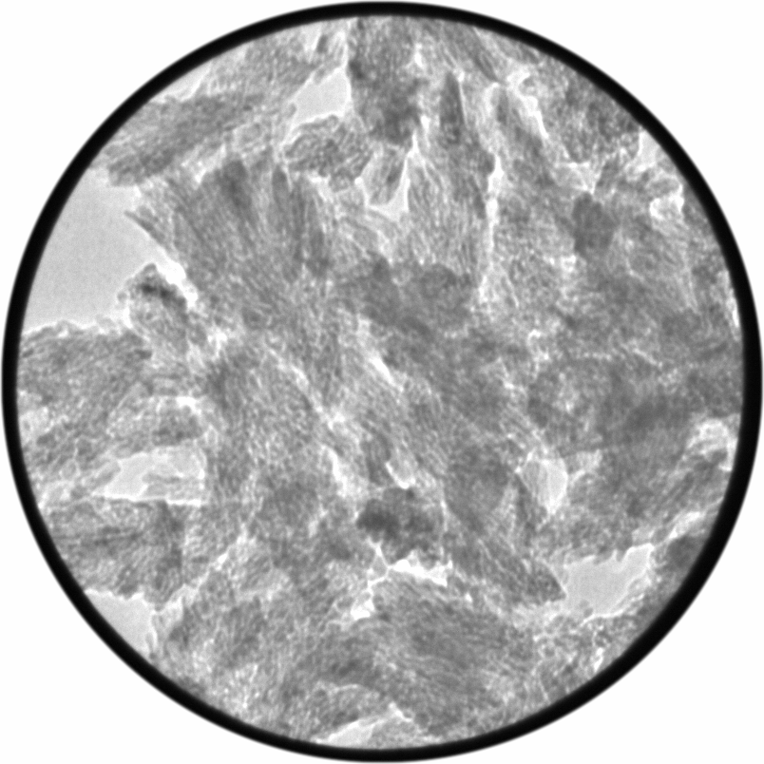
Structural Analysis of Nanomaterials
using Electron Diffraction
6μm
0.5μm
decreasing the selected area
intensity variation along the rings
fit
no texture
Can be modelled in MAUD using texture
analysis
fit
E-WIMV
data
data
Q (Å⁻¹)
Q (Å⁻¹)

Slide 16
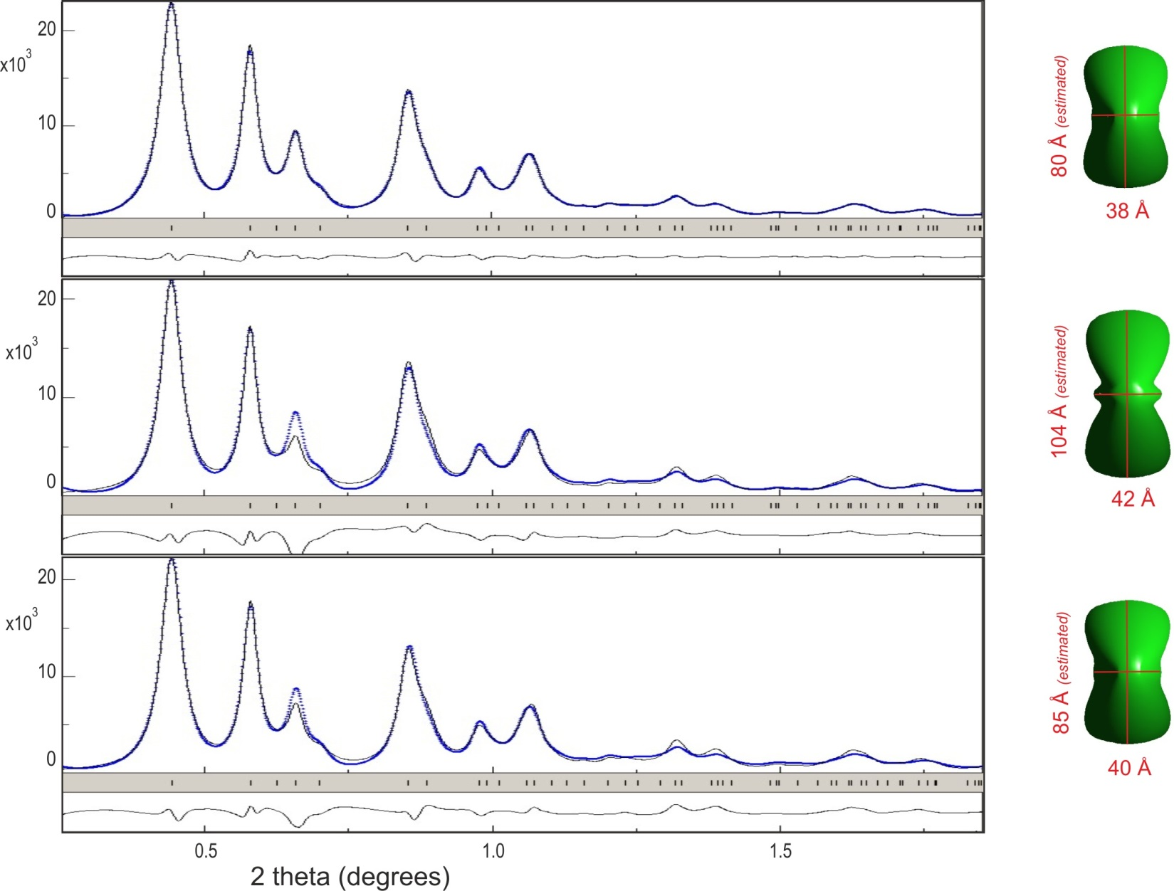
Structural Analysis of Nanomaterials
using Electron Diffraction
► Electron crystallography: more complicated than XRD due to dynamical conditions
✓
pattern matching
✗
structure factors
kinematical approx.
► microstructural features can be obtained in the pattern-matching mode
► not convincing using structure factors from kinematical approximation …
Take into account dynamical conditions ?

Slide 17
Structural Analysis of Nanomaterials
using Electron Diffraction
► Electron crystallography: more complicated than XRD due to dynamical conditions
2-beams or Blackman correction
ratio between the dynamical and kinematical intensity of a hkl reflection
H
in MAUD H can be:
a refineable thickness parameter
the anisotropic crystallite size used for line broadening
J₀ is the zero order Bessel function, Fhkl is the kinematical structure factor⁽*⁾, H is the thickness in Angstrom of the crystallite, Vc the cell volume, m and e are respectively the mass and charge of the electron, h the Planck constant and E the acceleration voltage of the microscope in Volts
⁽*⁾ electron atomic scattering factors from the tables of L.M. Peng et al., Acta Cryst. A52 (1996) 257.

Slide 18
Structural Analysis of Nanomaterials
using Electron Diffraction
► Electron crystallography: more complicated than XRD due to dynamical conditions
✓
pattern matching
✗
structure factors
kinematical approx.
✓
Blackman correction
(2-beams interactions)

Slide 19
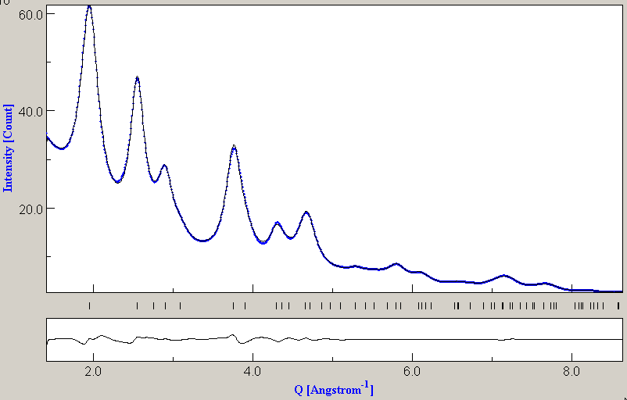
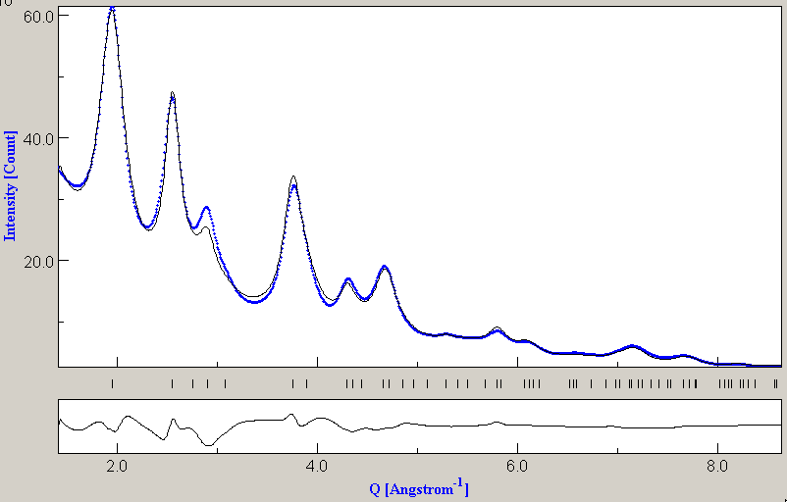
Structural Analysis of Nanomaterials
using Electron Diffraction
a=4.5875(2)Å c=2.9475(2)Å
XRPD
a=4.584(1)Å c=2.949(1)Å
x(O₁)=y(O₁)=0.3062(5)
pattern matching
POPA
R0 + R1
a=4.5853(3)Å c=2.9448(3)Å
x(O₁)=y(O₁)=0.3006(2)
2-beams
more reliable results
for structure refinement
Blackman 2-beams correction
x(O₁)=y(O₁)=0.3064(2)
structure refinement

